Slide 1


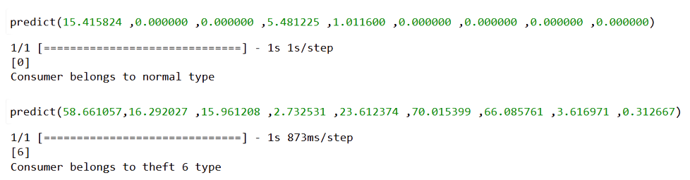
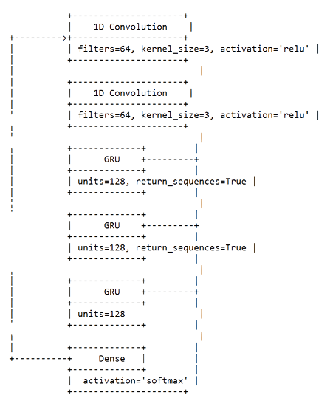
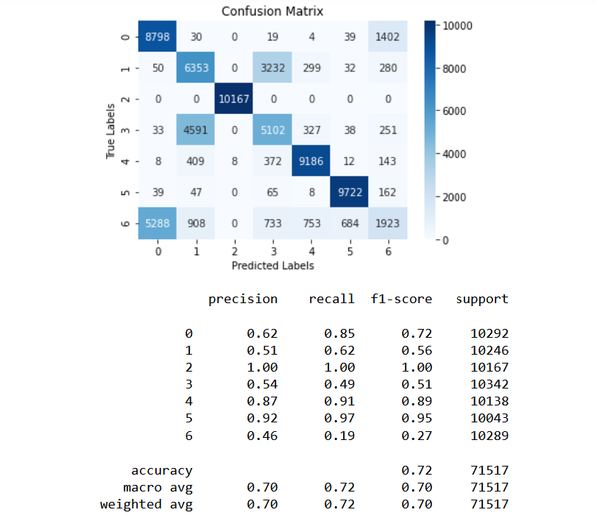
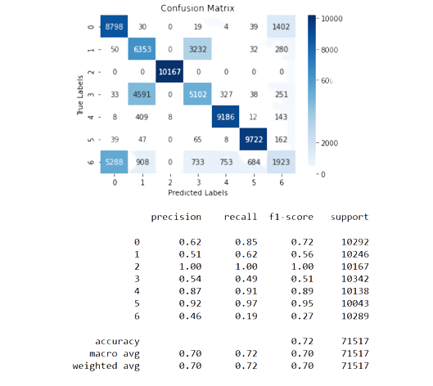
DEPARTMENT OF DATA SCIENCE CNN AND GRU - BASED DEEP NEURAL NETWORK FOR ELECTRICITY THEFT DETECTION BY JERRY ANTO M (215229113) Guide : Dr. Lovelin Ponn Felciah M
OBJECTIVE
Electricity theft is harmful to power grids, smart grids can help to solve the problem of electricity theft.
With the advent of smart meters, the frequency of collecting household energy consumption data has increased, making it possible for advanced data analysis.
The objective is to analyze the data of smart grids to detect abnormal electricity consumption pattern, which is helpful in detecting electricity theft.
INTRODUCTION
Non-Technical Loss problem is very unbalanced only a minor percentage of the total customer pursuit fraudulent activities.
Only 1% of the customers are committing fraud. Then, a trivial classifier that predicts always the negative class would achieve 99% accuracy.
A 1D-CNN-GRU network is used for electricity theft detection by analyzing the patterns in electricity consumption data over time.
MODEL ARCHITECTURE
PROPOSED SYSTEM
1d CNN-GRU model,Gated Recurrent Unit consist of Update and Reset gate which help to which holds the information
Feature selection and extraction are performed using CNN, which reduce both the dimensionality and the redundancy present in the dataset.
ALGORITHM APPLIED
CNN-GRU network is a deep learning architecture is a popular choice for sequential data analysis, including time-series data such as electricity consumption data.
The 1D CNN layer is used to extract local features from the electricity consumption data, such as spikes or drops in consumption.
The GRU layer is then used to capture patterns in the data, such as daily or weekly consumption patterns.
The combination of these two layers allows the model to learn complex patterns in the data and identify anomalies that may indicate electricity theft.
EXPERIMENTAL RESULT
CONCLUSION
This 1d CNN-GRU model used to detect abnormal electricity consumption pattern and also the type of theft.
INPUT & OUTCOME
REFERENCES
[1] Anish Jindal; Amit Dua; Kuljeet Kaur; Mukesh Singh; Neeraj Kumar; S. Mishra, Robust Electricity Theft Detection Against Data Poisoning Attacks in Smart Grids, IEEE Transactions on Smart Grid ( Volume: 12, Issue: 3, May 2021)

